Slide 1


McDonalds’s buzz analysis
Made by:
Turakulov A., Sitdikova Y., Rakhimkulova A., Yakovlev P.

Slide 2
Contents
01
02
Data parsing and preprocessing
Semantic analysis and the reputational metrics
03
04
Topic modeling
Recommendations

Slide 3
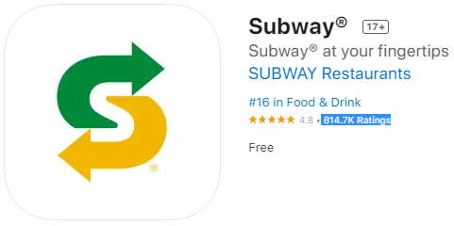
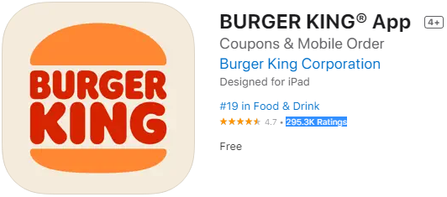
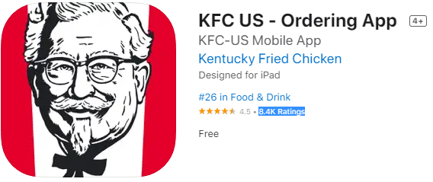
Competitors
The largest fast food restaurant chains by their number of locations in the world and revenue.

Slide 4
Data parsing and preprocessing

Slide 5


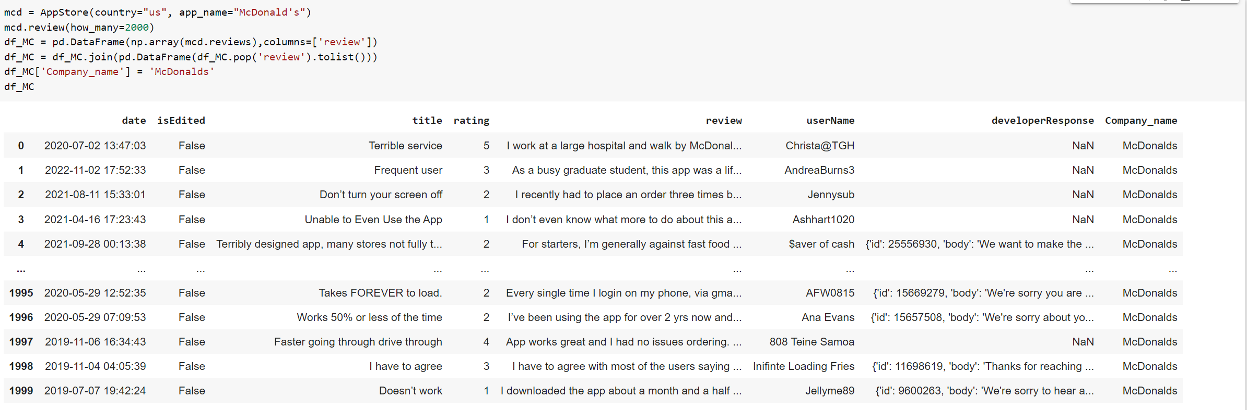

THE DATA PARSING
Reviews from the App store with the app_store_scrapermodule
2000 reviews
For each brand
Review date
Review text
Rating
Author account name
Developer response

Slide 6
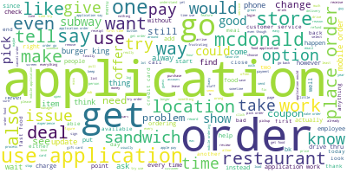
MOST POPULAR WORDS FOR BRAND

Slide 7
MOST POPULAR WORDS FOR EACH BRAND
SUBWAY
BURGER KING
MCDONALDS
KFC
count
application | 4025
order | 3531
get | 1459
subway | 1356
use | 1351
time | 1350
sandwich | 1157
go | 1150
store | 1060
make | 852
try | 840
would | 797
work | 772
one | 649
like | 643
want | 626
say | 621
place | 578
add | 554
even | 536
count
application | 3712
order | 2906
get | 1381
use | 1257
time | 1213
go | 1055
try | 841
burger | 751
work | 748
food | 672
would | 660
bk | 645
king | 636
say | 544
make | 541
restaurant | 524
offer | 500
coupon | 496
like | 487
even | 479
count
application | 6044
order | 5178
get | 2388
use | 2292
time | 2123
go | 1847
’ | 1389
deal | 1219
would | 1159
say | 1138
try | 1092
food | 1074
work | 1068
mcdonald | 1024
one | 949
make | 892
pay | 855
even | 845
tell | 813
like | 801
count
application | 456
order | 363
get | 156
go | 124
time | 121
kfc | 116
try | 92
store | 83
use | 82
say | 80
food | 80
would | 71
even | 67
wait | 62
chicken | 59
place | 54
pick | 54
location | 53
work | 52
make | 50

Slide 8
DELOVEPER RESPONSES
1613
1150
800
337
80% reviews answered
57% reviews answered
40% reviews answered
81% reviews answered
Subway
Burger King
McDonald’s
KFC*
*There are only 414 reviews

Slide 9
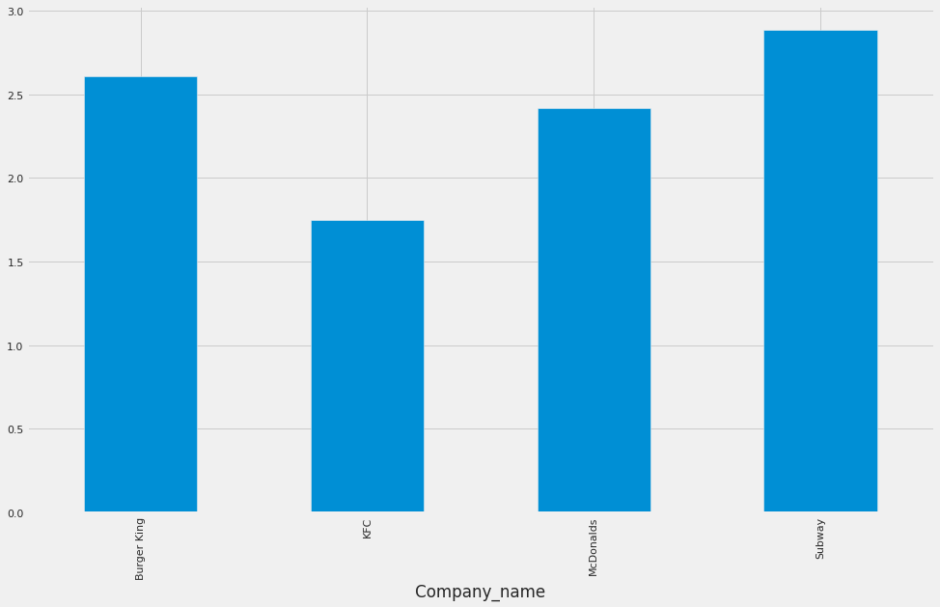
RATINGS OF THE COMPANIES
SUBWAY DEMONSTRATES THE HIGHEST AVERAGE RATING SCORE AMONG COMPETITORS
ratings
McDONALD’S PREVAIL KFC, HOWEVER LOSES TO BURGER KING AND SUBWAY IN RATING SCORES

Slide 10
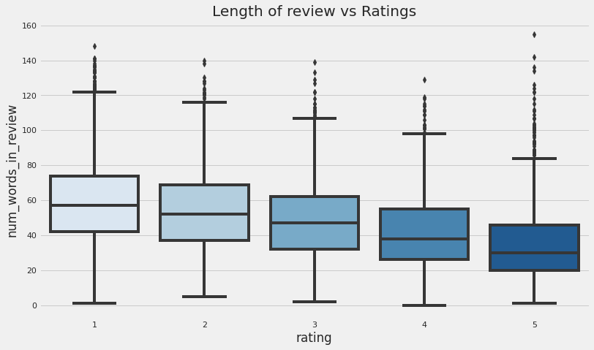
LENGHTS OF REVIEW VS RATINGS
THE LOWER THE RATING FOR THE APP, THE MORE WORDS IN AVERAGE THE REVIEW CONTAINS
=> USERS TEND TO EXPRESS THEIR OPINION IN A MORE EXPLICIT WAY IF THEY ARE UNHAPPY WITH THE SERVICE

Slide 11
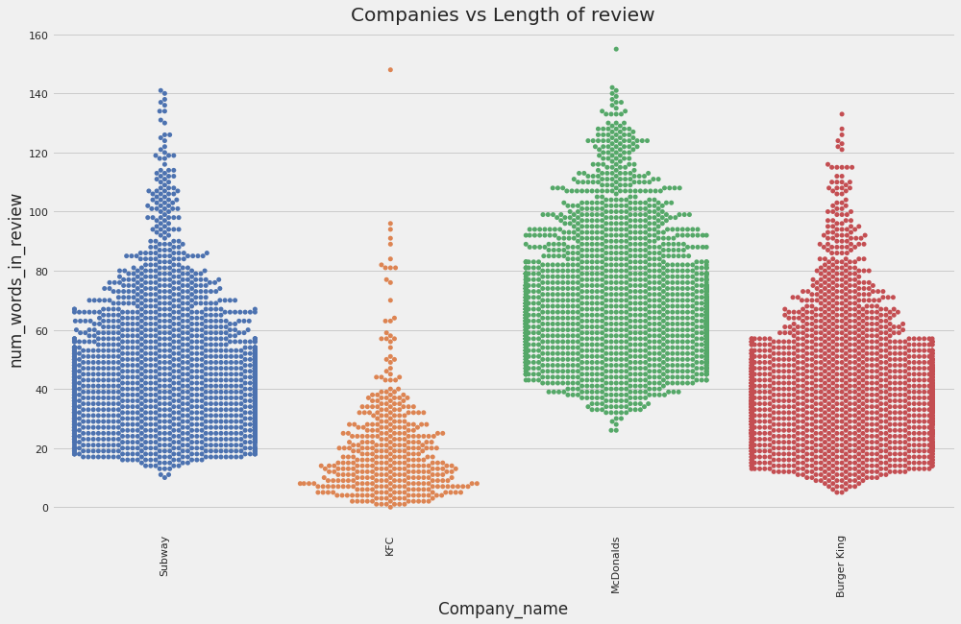
COMPANIES AND LENGHTS OF REVIEW
THE LONGEST REVIEWS ARE LEFT BY THE USERS OF THE MCDONALD’S APP

Slide 12
Semantic analysis and the reputational metrics

Slide 13
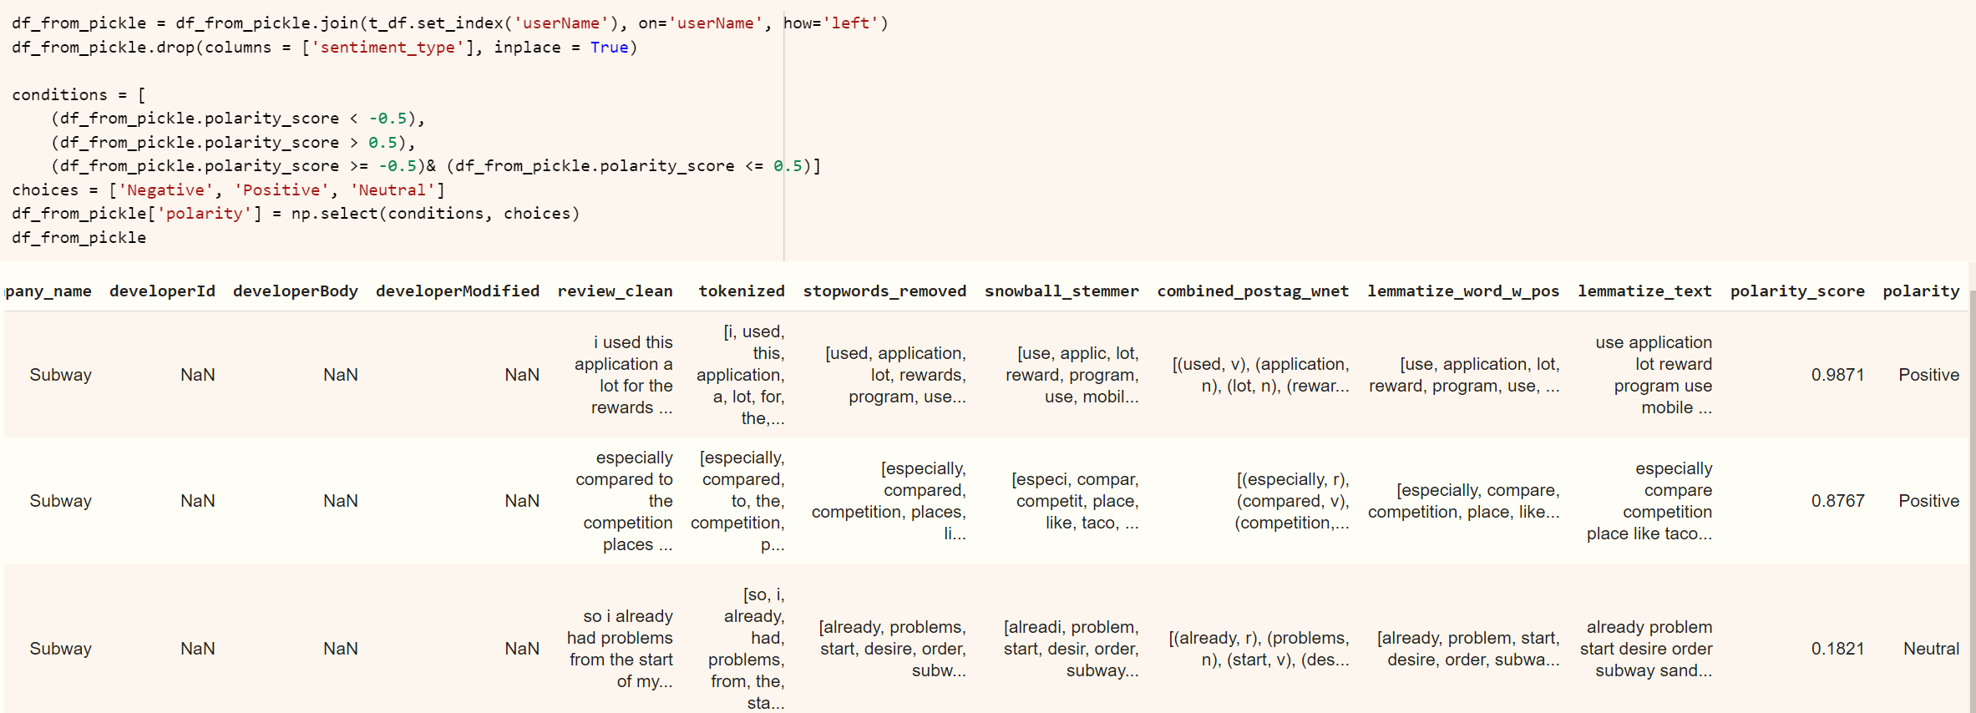
Semantic analysis
In order to perform sentiment analysis we will use the Valence Aware Dictionary and sEntiment Reasoner (VADER) in NLTK. The sentiment lexicon in VADER is a list of lexical features like words and phrases labeled as positive or negative according to their semantic orientation. Its rule-based approach is especially good at detecting sentiments in common applications like social media posts, product or service reviews, and survey responses.

Slide 14
Semantic analysis

Slide 15
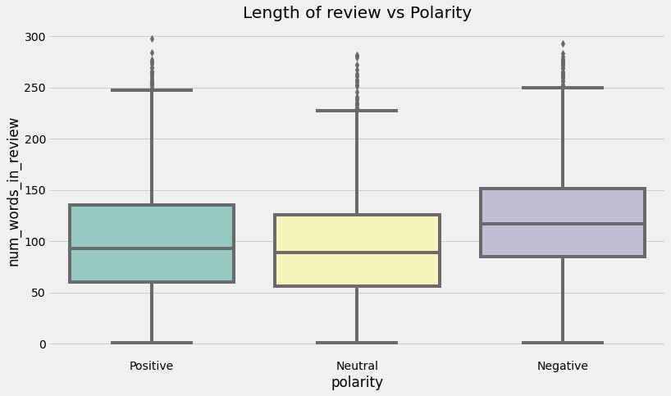
Semantic analysis
IF A REVIEW HAS NEGATIVE POLARITY, THE NUMBER OF WORDS INCREASES – THE SAME AS IN CASE WITH RATINGS

Slide 16
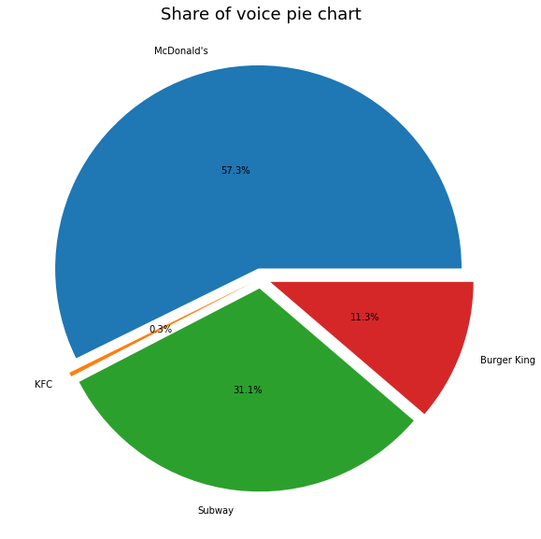
SHARE OF VOICE
MCDONALD’S HAS THE LARGEST SHARE OF VOICE

Slide 17
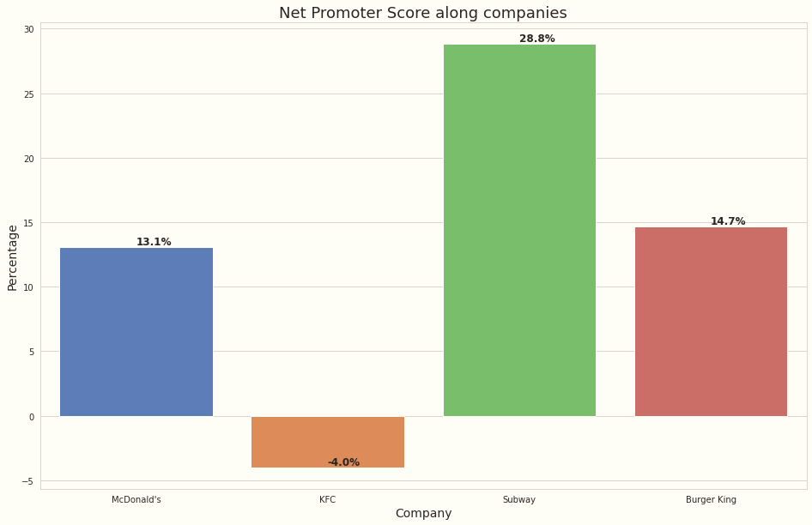
NET PROMOTIONAL SCORE
Subway has the highest NPS.

Slide 18
Topic modelling

Slide 19

Preprocessing
In order to perform topic modeling, some preprocessing should be made: we take the already cleaned up, tokenized and lemmatized text column from preprocessed dataset. Also, we enlarge the set of stopwords:
Next, we create a dictionary and filter extremes:
filter_extremes() does the following:
no_below: remove words that appear less than in 5 reviews
no_above: remove words that appear in more than 50% reviews
keep_n: after (1) and (2) keeps n words by frequency

Slide 20
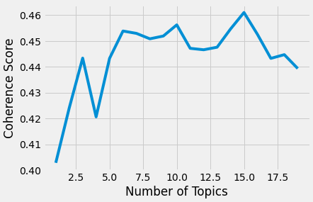
MODEL CREATION
Latent Dirichlet Allocation (LDA) is a generative probabilistic model that assumes each topic is a mixture over an underlying set of words, and each document is a mixture of over a set of topic probabilities.
To keep things simple, we set initially inputting the number of topics (10). Next, we build a model with 10 topics where each topic is a combination of keywords, and each keyword contributes a certain weightage to the topic
Next, we created a function to find the optimal number of topics with the coherence scores. Coherence score in topic modeling to measure how interpretable the topics are to humans. In this case, topics are represented as the top N words with the highest probability of belonging to that particular topic. Briefly, the coherence score measures how similar these words are to each other

Slide 21
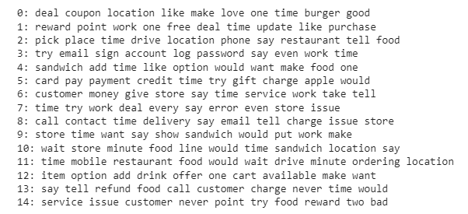
Topics from the LDA model
Finally, we get 15 topics (optimal number) with top10 words for each topic

Slide 22
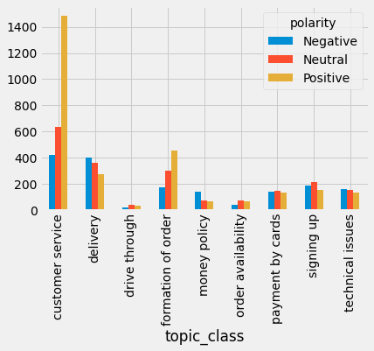
POLARITY OF THE REVIEWS BY TOPIC
Each of the topics indicates customers opinion about certain area.
The most common topics that is discussed by customers are the customer service conditions, delivery conditions and specifics about the formation of the order.

Slide 23
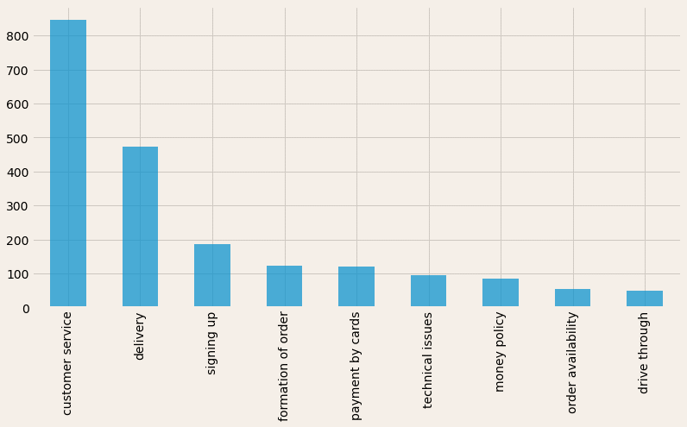
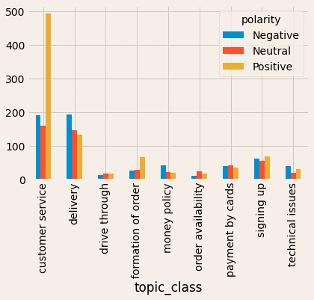
MCDONALD’S

Slide 24
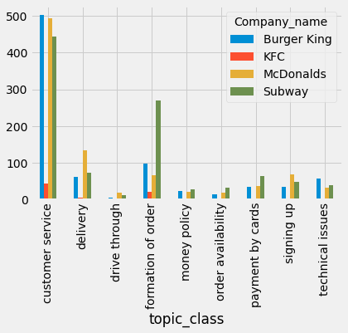
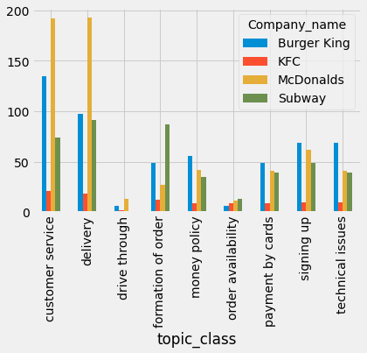
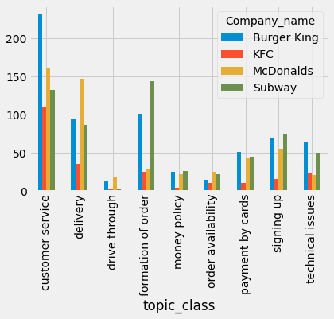
MCDONALD’S AND COMPETITORS
Positive
Negative
Neutral

Slide 25
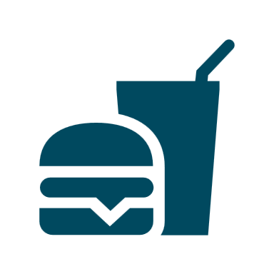

Key findings
Industry
Brand
Users tend to express their opinion in a more explicit way if they are unhappy with the service than if they are satisfied.
The most common topic that is discussed by the customers are the customer service conditions, delivery conditions and specifics about the formation of the order
Review ratings among the industry are quite low in average.
Brand has a leading position in an industry (SOV #1)
Brand has positive NPS which indicates that customers are satisfied with the company's offers. However, the metrics is lower than what direct competitors have, there is a potential to grow.
The brand has rating around 2 which is quite low and less than competitors.
Mcdonald’s has the largest number of negative reviews.
People more often highlight customer service of Mcdonald’s in a positive perspective and delivery conditions, technical issues and signing up terms in a negative perspective.

Slide 26
Recommendations
Enhance brand factors that is discussed the most by the audience
McDonald's customers mostly comment about customer service, delivery and about the signing up. As these are the factors are most commonly address by the audience, the brand should focus on them and address audiences needs.
Address the negative comments
The number of negative feedback overweighs the positive ones in the segments of delivery, technical issues, payments conditions. These are the areas that can be improved by the brand from the side of technical improvement, as well from the communication with the audience and restoring their trust and loyalty.
Learn from competitors
In some of the areas competitors have gain more respect from the audience side in reviews. For example, Subway has the highest rating among competitive group and is leading in topics of formation of the order, payments by the card in a positive way.
Increase the brand response on customer reviews
Only 40% of reviews are answered by the brand representatives, which is lower than competitors.
Hidden marketing
Enhance the brand’s appearance with the ordinary users that might initiate the "non-advertising" discussions. The user is more likely to give negative feedback than to praise the company. Therefore, the work on positive reviews largely falls on the shoulders of business

